Slide 1

Employee Payroll Management
Group -2
Ashwini D S 2486796
Aniket Suresh Dhumal 2485061
Aniket Laxmanrao Jadhav 2484879
Anil Kumar Verma 2484729
Anusha K M 2484712
Apoorva B R 2485174
Andalam Maddiletaiah Srinivasa Sreekant 2486693
Asadi Bharadwaj 2485071
Balaraju Damodar Raju 2484894
Basireddy Gari Mohan Reddy 2483226
Arvapalli Manivarma 2485995

Slide 2

Bibliography
www.google.com
www.javatpoint.com
www.youtube.com
www.stackoverflow.com
WWW.spring.io

Slide 3

Contents
Objective
Tools & Languages used
System Requirements
App Flow
E-R Diagram
Features of Employee payroll management
Future scope and improvements
Conclusion

Slide 4
Objective
The main objective of the Employee Payroll Management System is to automate and streamline micro tasks such that the HR team has time to focus on the macro tasks.
One don’t have to worry about handling, managing and creating payslips.
Attendance, Work Schedule, Time Sheets etc..
It manages and stores all the personal information off Admin, Employees.
The project is totally built at administrative end and thus only the administrator is guaranteed the access.
Practically : The system is quite stable and can be operated by the Employees with average intelligence.
Efficiency : We tried to involve accuracy, timeliness and comprehensiveness of system output

Slide 5







Tools & Languages used
Front End
Angular
HTML
CSS
BOOTSTRAP
Visual Studio
Back End
Spring Tool Suite
MySQL
Hibernate
Postman

Slide 6
System Requirements
The Basic System Requirements for Running this project are listed below:
Angular, STS, Postman and MySQL to be installed to the system
572 MB Random Access Memory
200 MB of Free Space on Hard Disk
Microsoft Windows XP or Linux or Equivalent OS
Web Browser

Slide 7
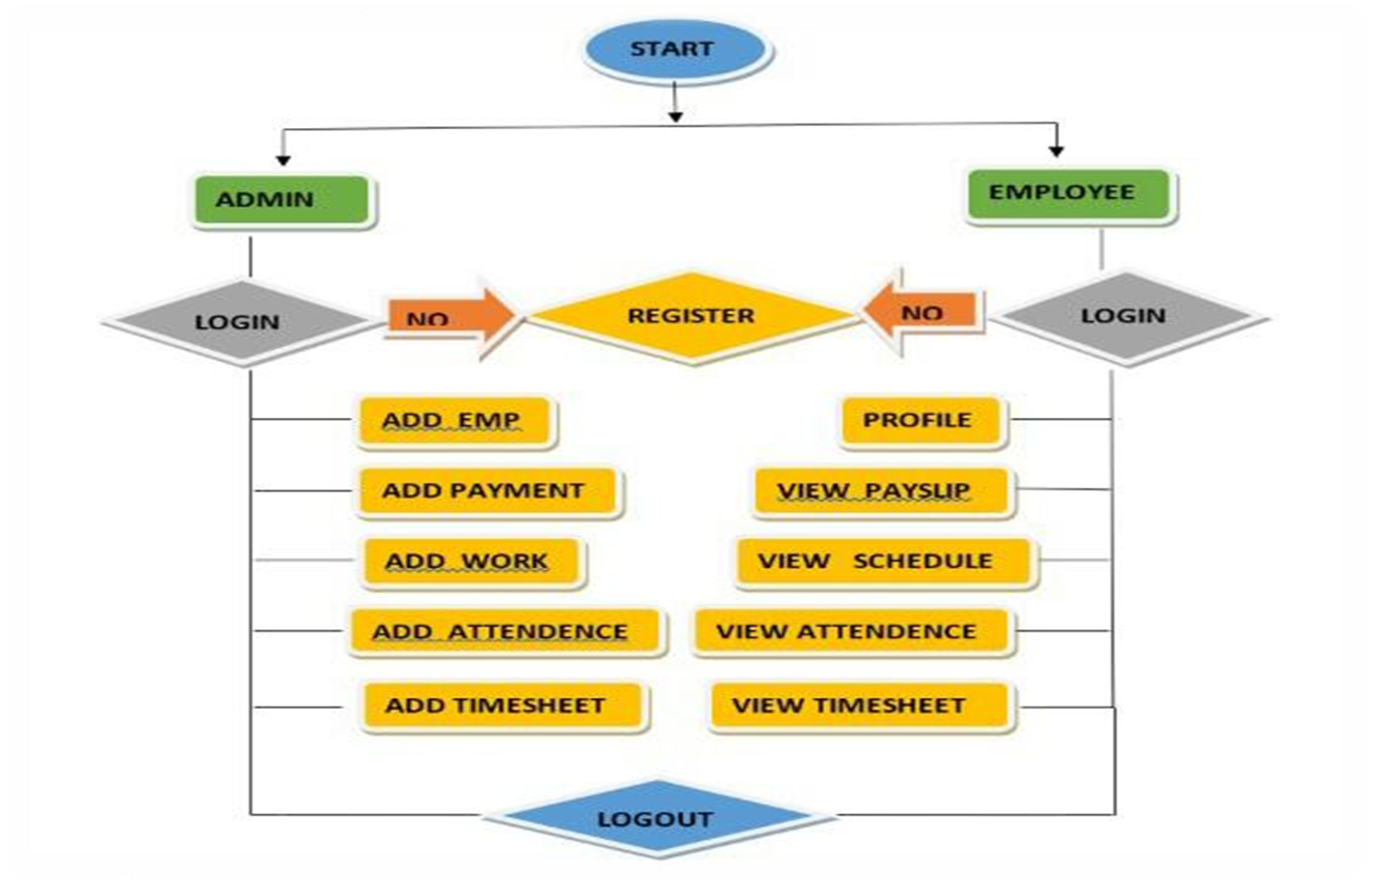
App Flow

Slide 8
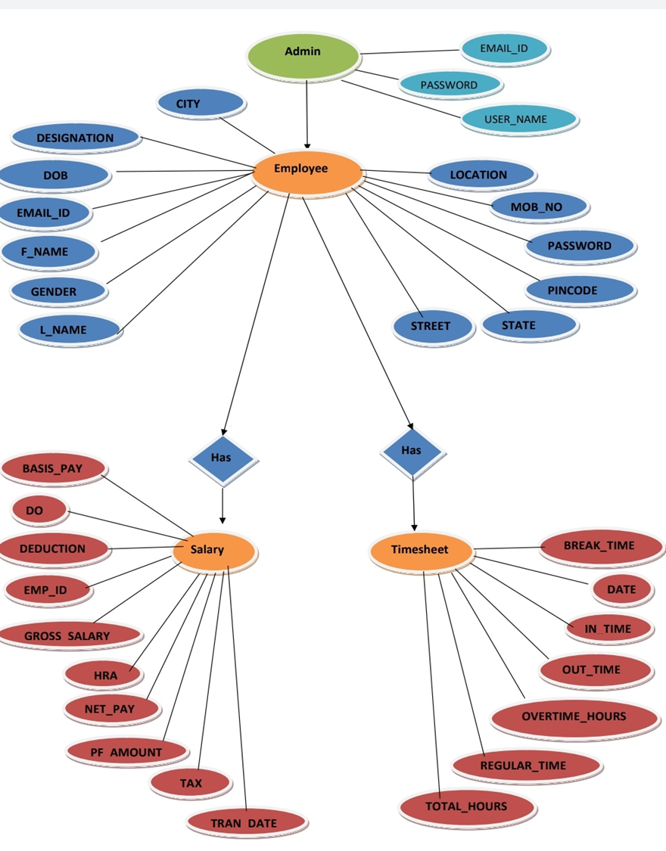
E-R Diagram

Slide 9



Features of Employee payroll management
Easy to use.
It is completely secure.
It is completely controlled by admin.
This system is easily compatible with most of the web browsers.
It is very interactive and saves time.
Reduces paper works.
Calculations are automated so it is highly accurate.
Admin can view all the records whenever necessary with ease.

Slide 10
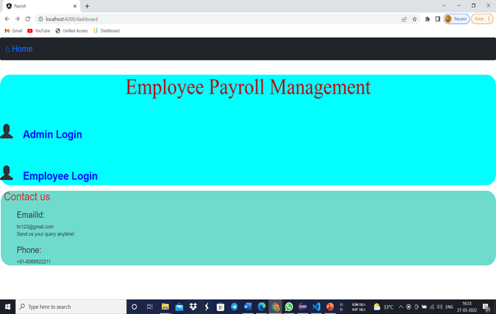
Output Screenshot
Homepage:

Slide 11
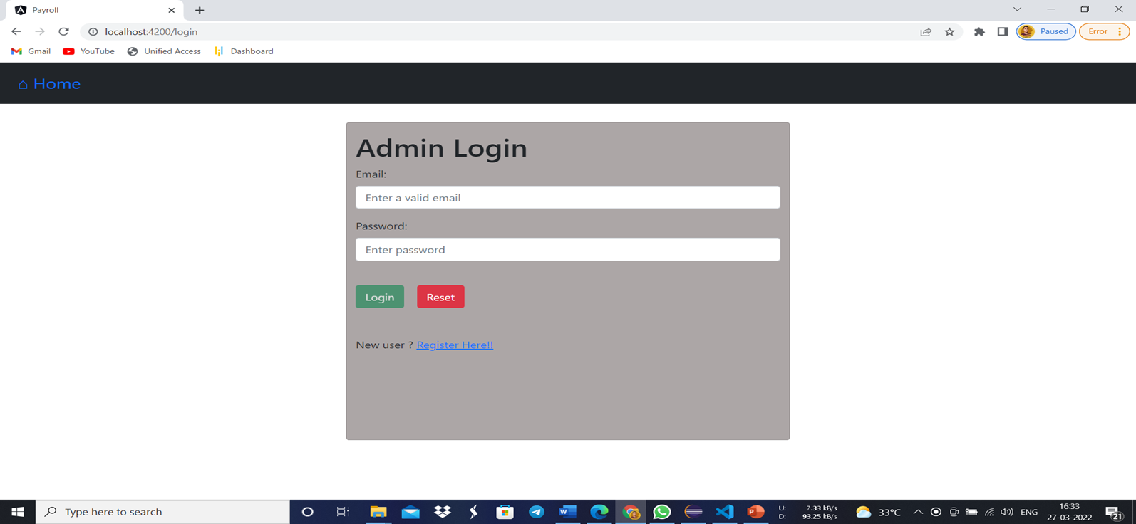
Output Screenshot
Admin login:

Slide 12
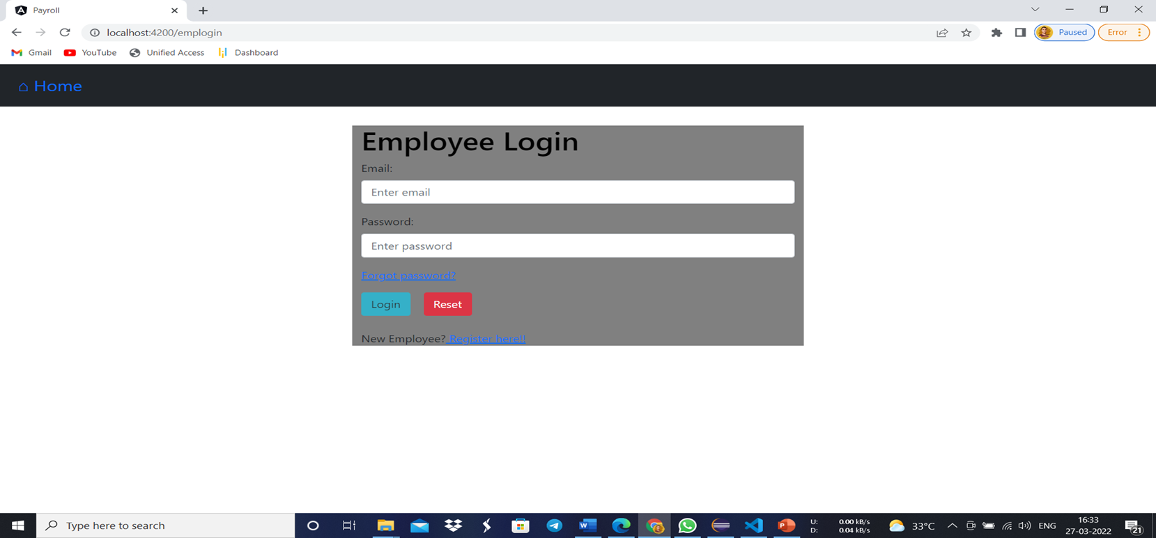
Output Screenshot
Employee login:

Slide 13
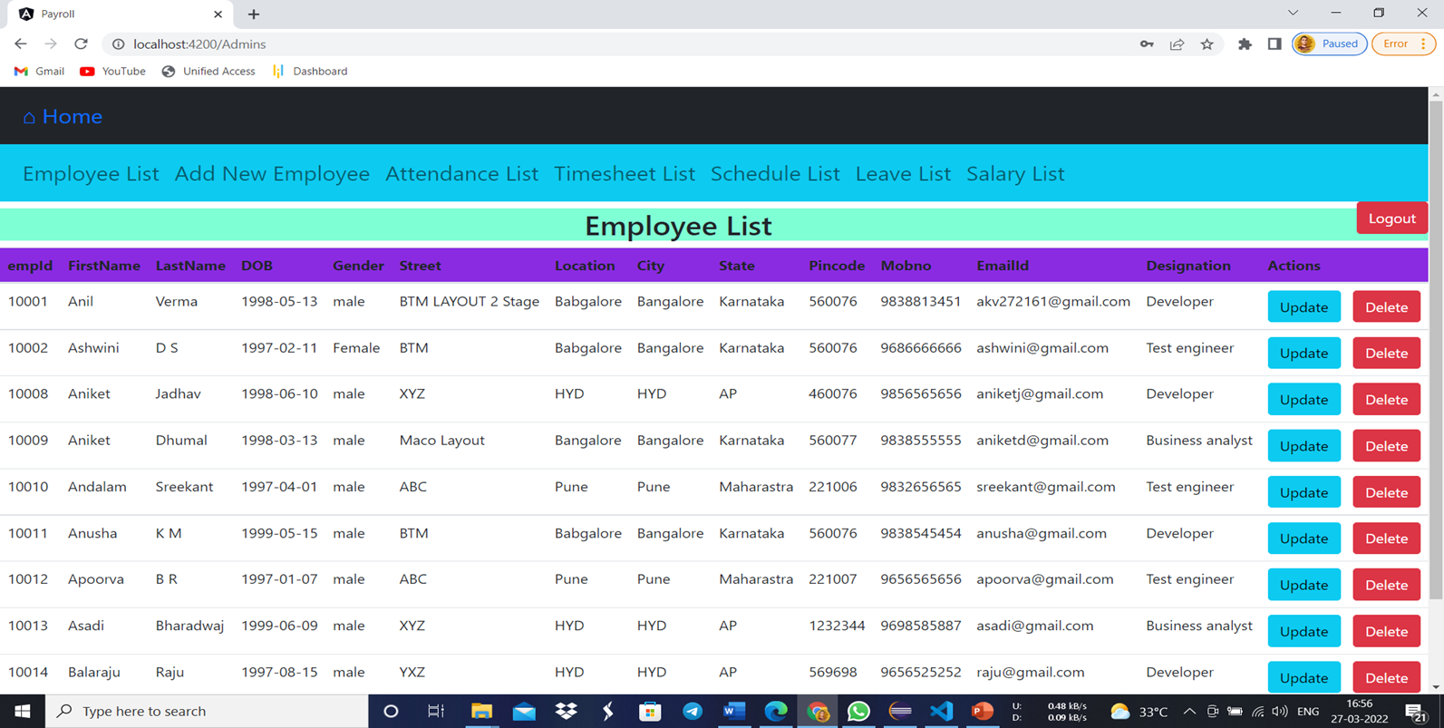
Output Screenshot
Employee list:

Slide 14
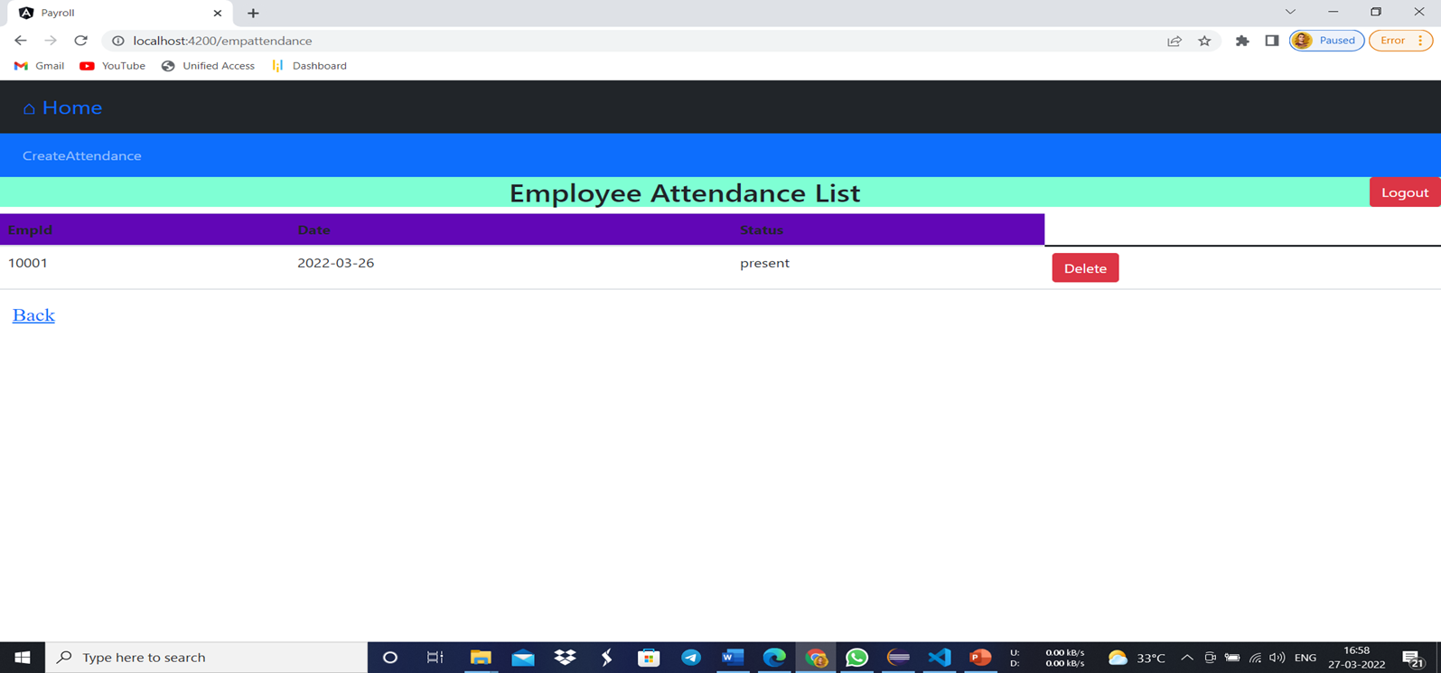
Output Screenshot
Employee Attendance List:

Slide 15
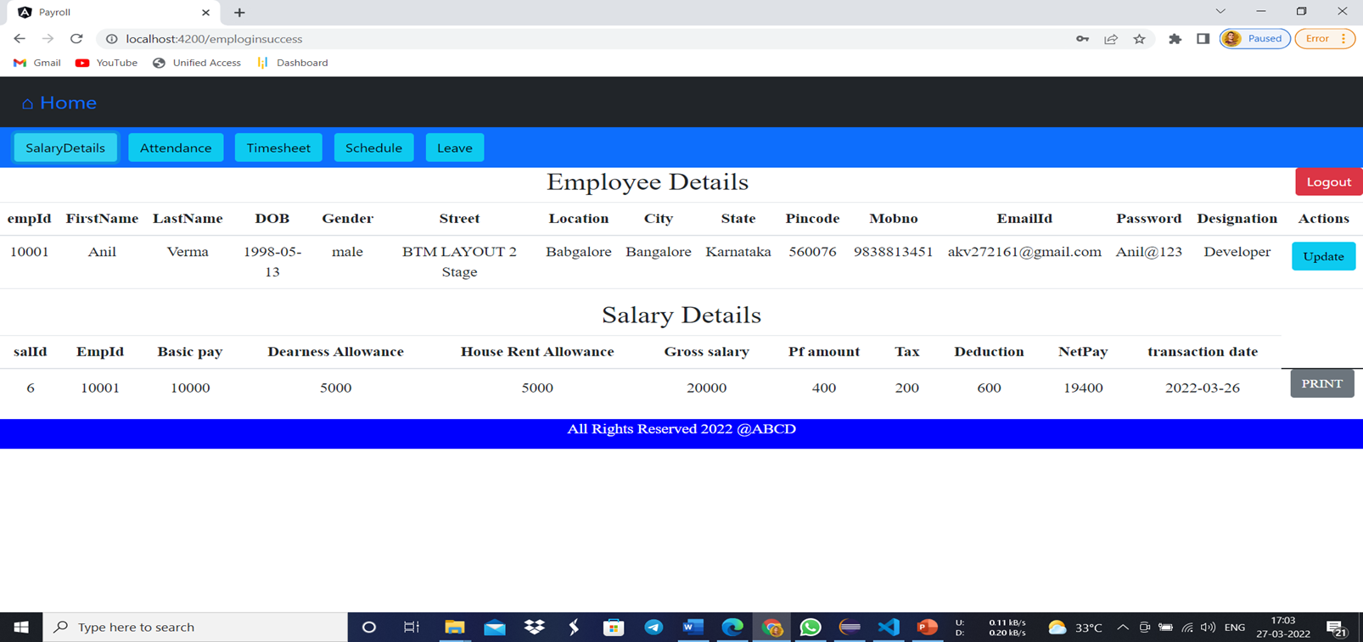
Output Screenshot
Employee Profile and Payslip:

Slide 16
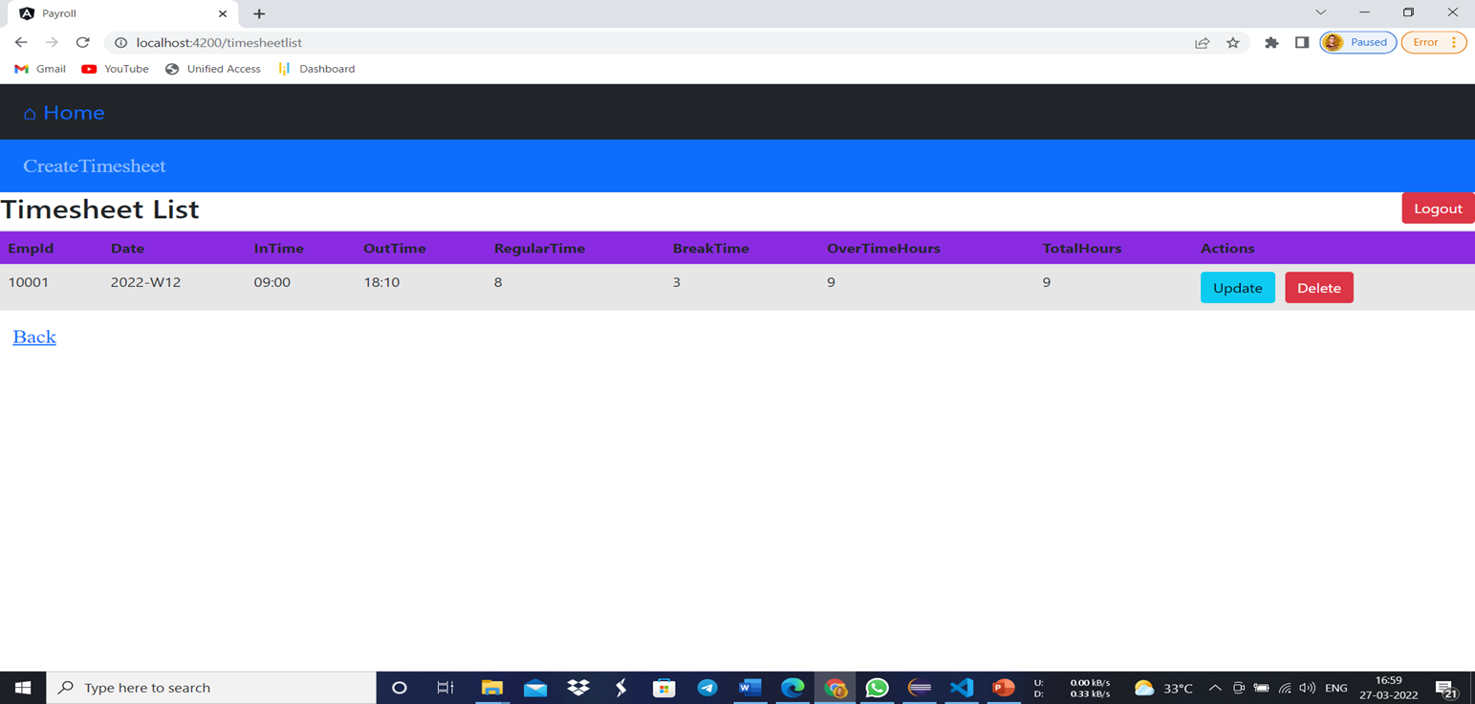
Output Screenshot
Timesheet List:

Slide 17
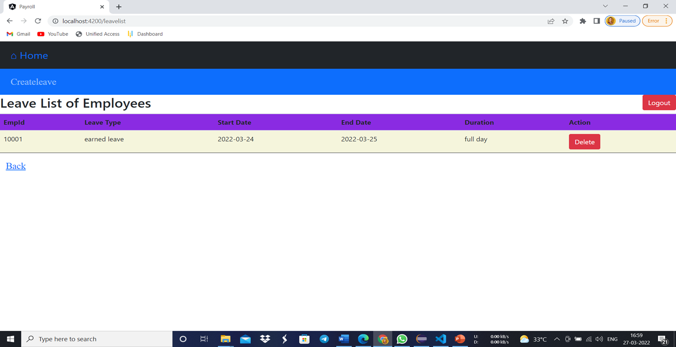
Output Screenshot
Leave List:

Slide 18
Future scope and improvements
This Application works in Multiple PC’s installed on multiple Computers but sharing same database by which users of different department can use it sitting at different locations simultaneously.
But in future we can make the Application where the database will be hosted in order to manage the all departments which will be located in different places and by keeping domain of Application as Online.
The system can be developed in such a way that its existing features can be modified to better versions.

Slide 19

Conclusion
This project is built keeping in mind that it is to use by admin and the employees in an organization.
It is built for use in small scale organization where the number of employees is limited. According to the requested requirement the admin can add, manipulate, update and delete all employee data in his organization.
The admin can add new Employee and delete them. The Admin can also add predefined pay grades for the employees. The required records can be easily viewed by the admin anytime time he wants in an instant.
The payment of the employee is based on monthly basis. Numerous validations implemented would enable the admin to enter accurate data. The main objective of this framework is to save time, make the system cost effective and management records efficiently.

Slide 20
ThanK-YOU

